Slide 1
Healthcare Analytics

Slide 2
Agenda
Business Context
Data availability
Data Analysis
Dashboard
Cost Analysis & Overcharging Detection
Least Similar Providers and Region
Anomalous Patient Detection
Predictive Modelling

Slide 3
Business Context
Medicare reimburses private healthcare providers for medical procedures, ensuring access to essential care for millions of individuals. However, discrepancies in billing, unexpected cost variations, and potential fraudulent claims pose challenges to maintaining a fair and efficient system.
This project focuses on analyzing Medicare data to detect anomalies—identifying providers that overcharge, procedures with extreme cost variations, and regions where medical expenses are unusually high. By uncovering these patterns, we aim to enhance cost transparency, prevent overbilling, and ensure the integrity of the reimbursement process.
Notes:
Medicare helps to cover the medical costs by reimbursing private healthcare providers for the procedures they perform. But sometimes, there are issues like unexpected cost differences, incorrect billing, or even fraudulent claims, which can make the system unfair and inefficient.
This project is all about analyzing Medicare data to find unusual patterns—like providers charging too much, procedures with big cost differences, or certain regions where medical costs are much higher than expected. By identifying these issues, we can improve transparency, prevent unfair billing, and make sure the system remains fair and reliable.

Slide 4
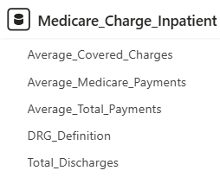
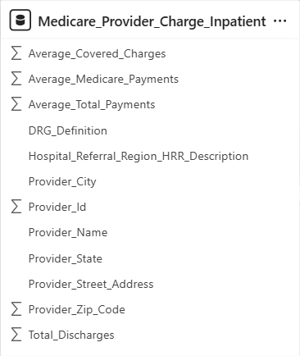
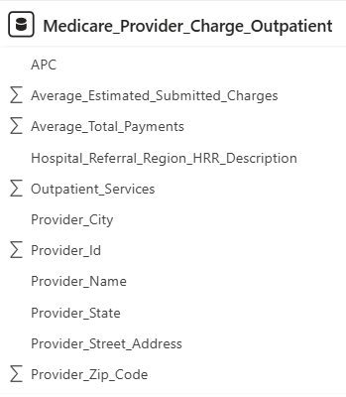
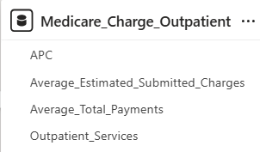
Data Availability

Slide 5
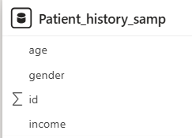

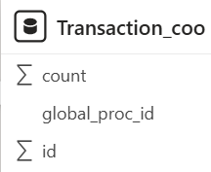
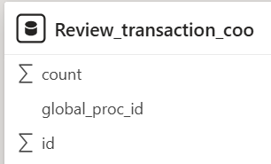
Data Availability
Tables Available:

Slide 6
Data Analysis
Image source: icons8`

Slide 7
Data Import & Preparation
Imported CSV File: Used Flat File Import to load data into SQL Server.
Stored Dataset: Organized data into SQL Server tables for efficient querying and analysis.
Data Understanding & Cleaning
Checked Data Types: Verified the data type of each column.
Row Count Analysis: Identified the number of records in each table.
Null Value Handling: Detected missing values and applied appropriate handling techniques

Slide 8
Exploratory Data Analysis (EDA)

Slide 9
Inpatient vs. Outpatient Provider,
Procedure Count
and Discharge Count
Total Inpatient Procedures | 100
Total Outpatient Procedures | 30
Inpatient Provider Count | 3,337
Outpatient Provider Count | 3,135
Total Inpatient Discharge | 69,75,318
Outpatient Service | 2,55,01,910

Slide 10
Inpatient vs. Outpatient Provider, Procedure Count and Discharge Count
Insights:
More Inpatient Procedures – Inpatient procedures (100) are much higher than outpatient (30), indicating a hospital-focused approach.
Balanced Provider Availability – Inpatient (3,337) and outpatient (3,135) providers are nearly equal, ensuring service accessibility.
Higher Outpatient Demand – Outpatient services (2.55 crore) far exceed inpatient discharges (69.75 lakh), showing patient preference.
Recommendations:
Improve Outpatient Care: Build better outpatient facilities so fewer people need to stay in the hospital.
Use Resources Wisely: Adjust the number of staff and resources based on how many patients are there to provide the best care.

Slide 11
Medicare's Contribution to Total Payments
27%
23%
Average % of amount paid out of the total bill
Average % of amount paid by Medicare out of the total bill
85%
Medicare contributes out of the total amount that gets paid

Slide 12
Medicare's Contribution to Total Payments
Insights:
Patients Face High Costs – On average, patients pay 27% of their total bill out of pocket, which can be a financial burden.
Medicare Covers a Small Share – Medicare pays for only 23% of the total bill, raising concerns about whether coverage is enough.
Medicare’s Key Role in Payments – Out of the total amount that gets paid, 85% comes from Medicare, shows that the healthcare system relies heavily on Medicare funding to ensure payments are made
Recommendations:
Reduce Out-of-Pocket Costs – Explore subsidy programs or secondary insurance options for patients.
Enhance Medicare Coverage – Assess potential policy adjustments to increase the 23% Medicare contribution.

Slide 13
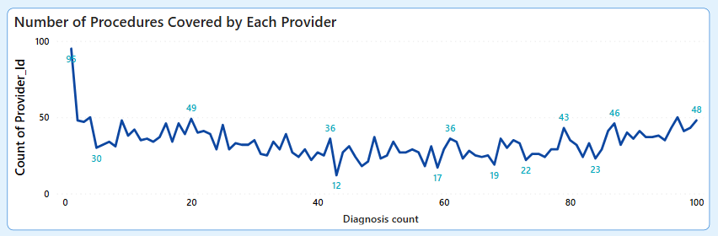
Number of Procedure Covered by Each Provider
Providers covering fewer diagnoses are more common, while specialized providers handle higher diagnosis counts, showing a fluctuating yet increasing trend.
Image source: icons8`
Notes:
most providers cover a limited number of procedures, while a few providers handle a higher volume of diagnoses. The trend fluctuates but shows an overall increase in provider count as the diagnosis count rises.

Slide 14
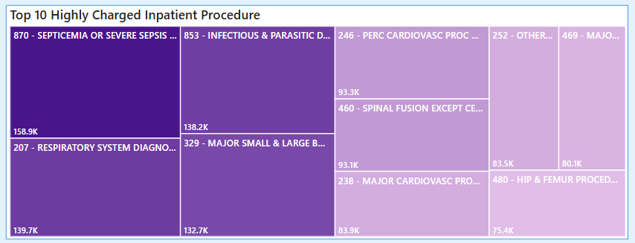
Highly Charged Inpatient Procedure
Darker color in the chart signifies the highest charges, with Septicemia or Severe Sepsis W MV 96+ hours having the highest cost. Lighter colors represent lower charges, with Hip and Femur procedures still contributing significantly.
Image source: icons8`

Slide 15
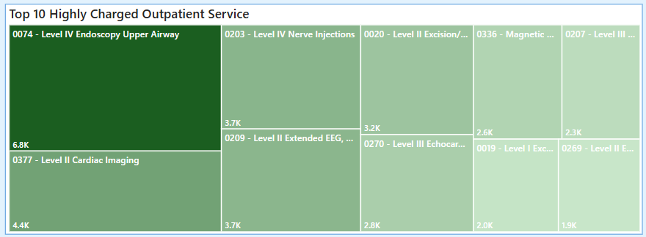
Highly Charged Outpatient Procedure
Darkest green section represents the highest-charged outpatient service, which is Level IV Endoscopy Upper Airway (6.8K). Other services like Cardiac Imaging and Nerve Injections have relatively high charges but are lower in comparison. The lighter the green, the lower the charge for that service.
Image source: icons8`

Slide 16
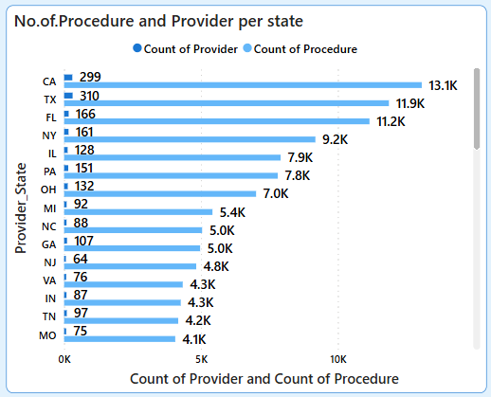
Number of Procedure and Provider per State
CA, TX, and FL lead in both provider count and procedure volume.
Higher provider counts generally correspond to higher procedure counts, but some state(e.g., PA, OH) have fewer providers handling a significant number of procedures.
Smaller states (e.g., MO, TN, IN) have lower counts, indicating fewer healthcare providers and procedures.
Image source: icons8`

Slide 17
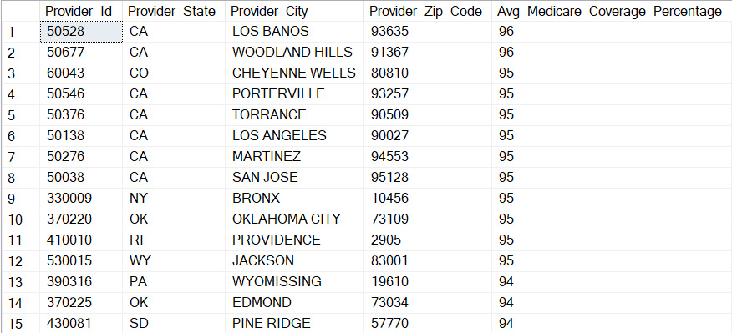
Geographical Locations of Highest Medicare Coverage Providers
Max providers are from Tx and CA indicates a strong healthcare access
High Medicare coverage is distributed across both urban and rural areas in multiple states, indicating a strong nationwide provider network.

Slide 18
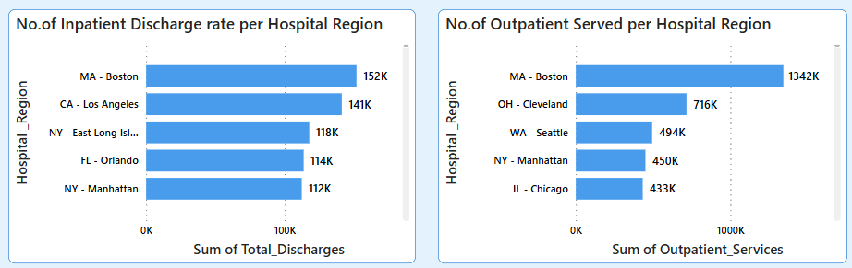
Total Discharge Rate Per Hospital Region
Boston leads in both inpatient discharges (152K) and outpatient services (1342K), indicating a high patient volume.
Los Angeles and East Long Island see more inpatient discharges, while Cleveland and Seattle rank high in outpatient services.
Image source: icons8`

Slide 19
DASHBOARD
Image source: icons8`

Slide 20
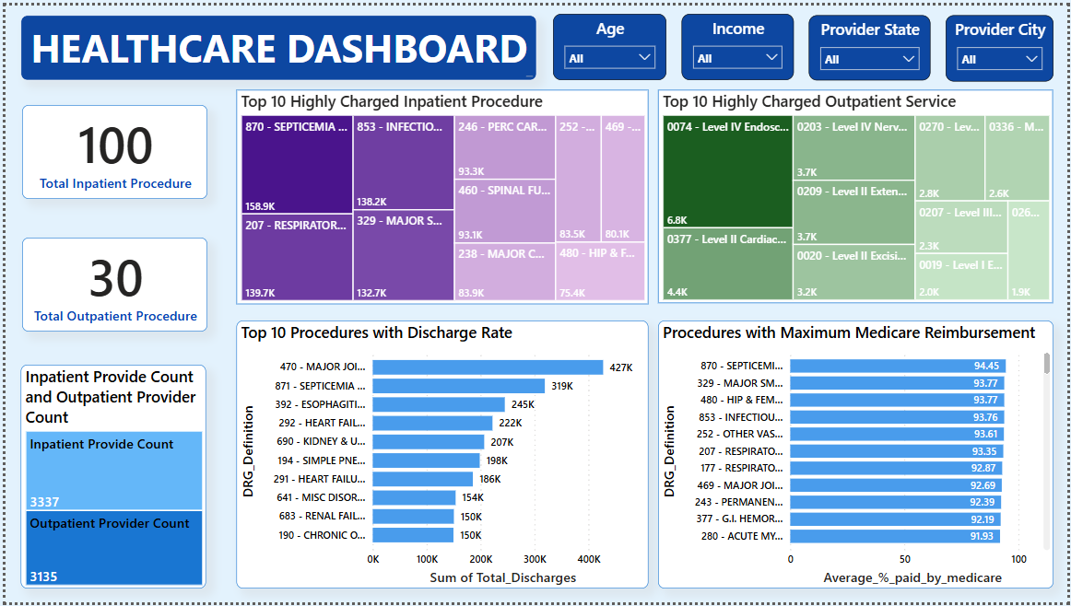
Image source: icons8`

Slide 21
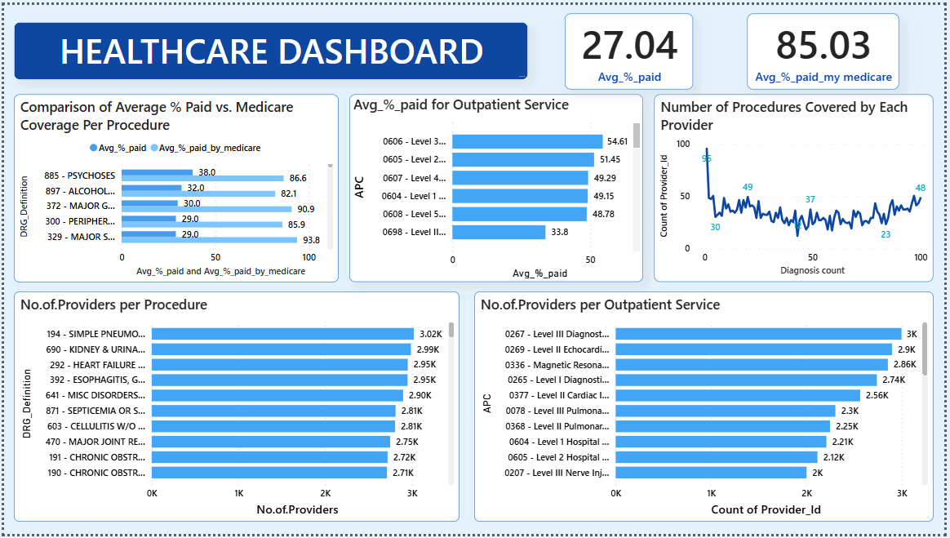
Image source: icons8`

Slide 22
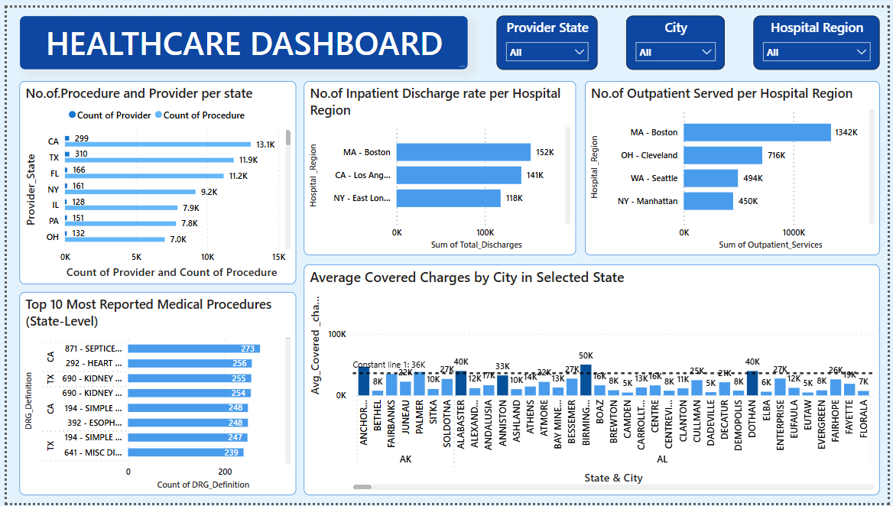
Image source: icons8`

Slide 23
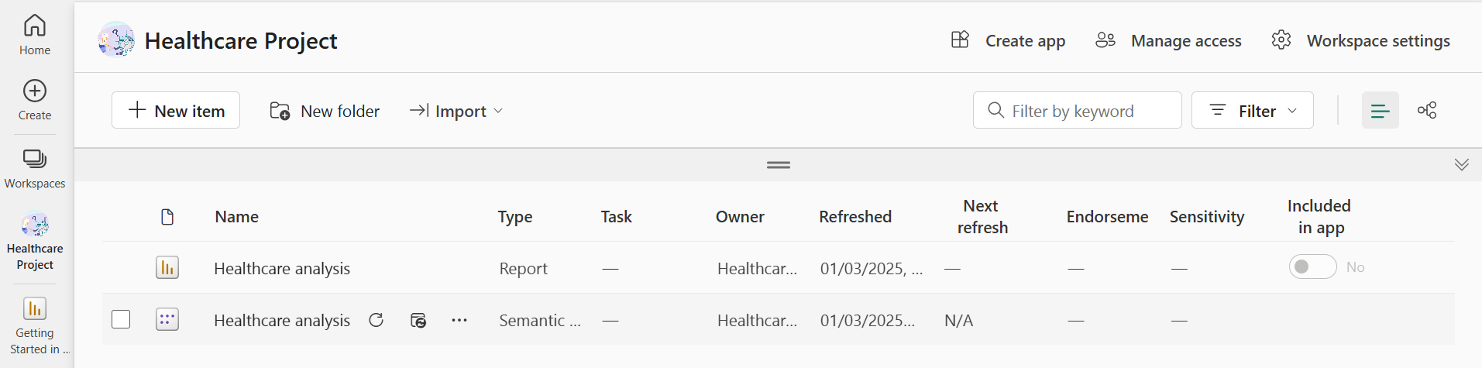
Power BI Dashboard Deployment to Power BI Server
The Power BI dashboard was published to “Healthcare Project" in Power BI Service for easy access and sharing.

Slide 24
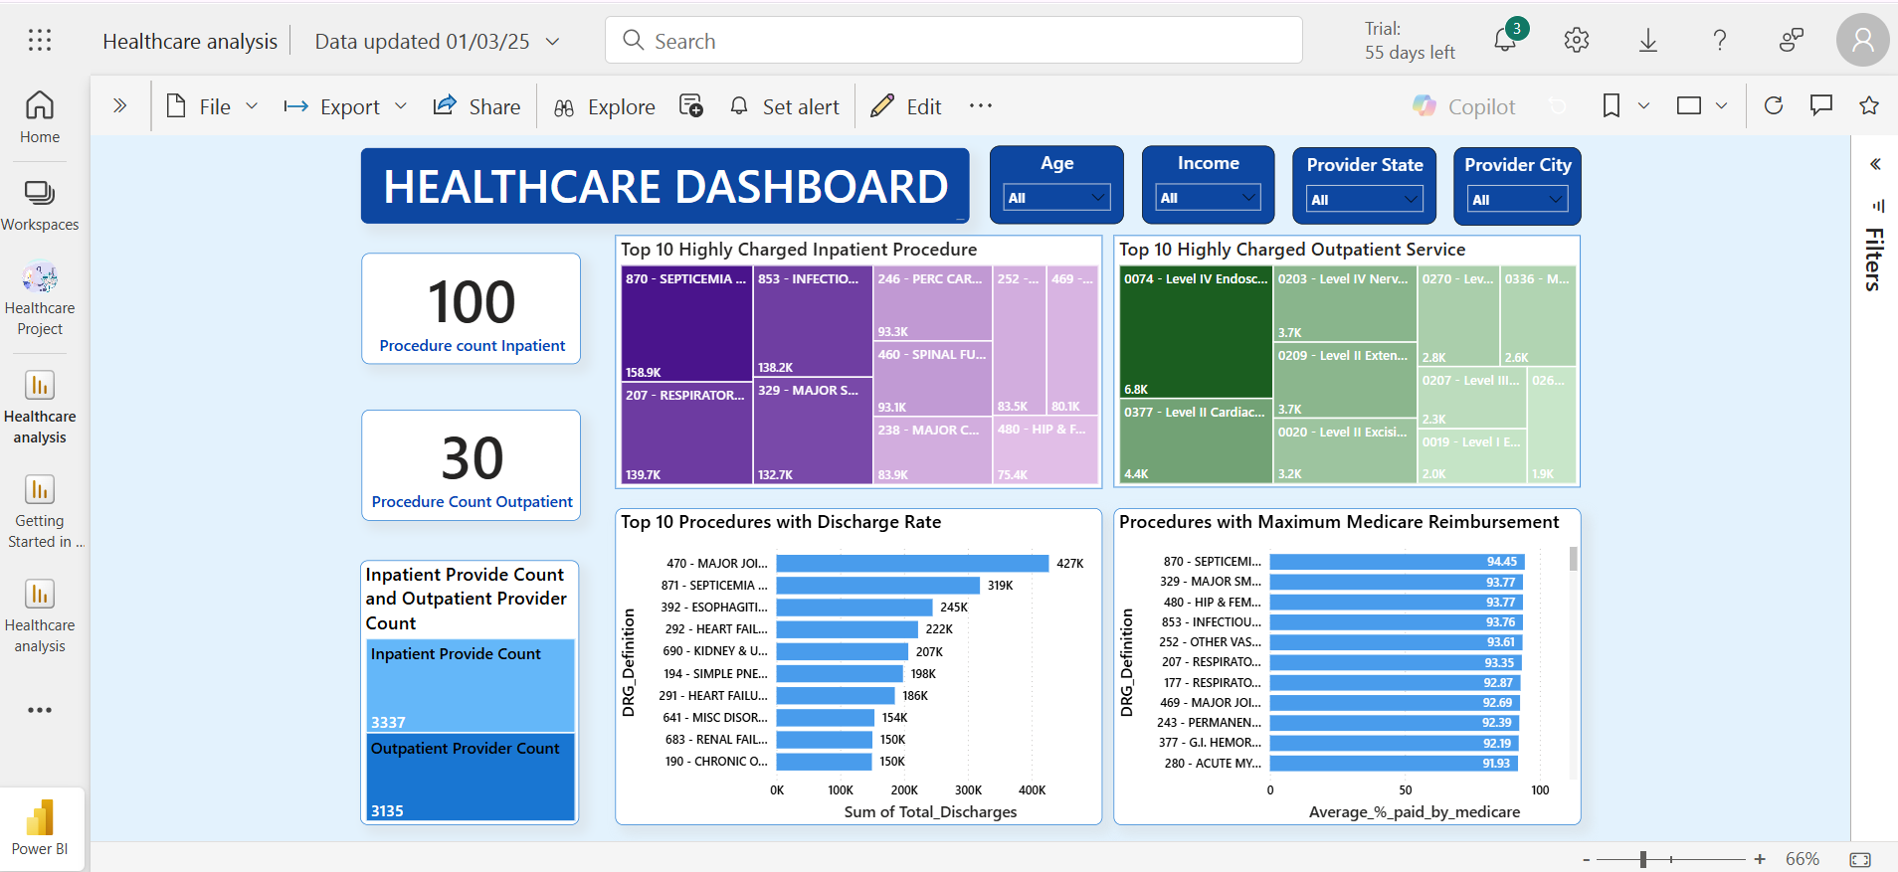
Image source: icons8`

Slide 25

Cost Analysis
&
Overcharging Detection
Image source: icons8`

Slide 26
Connecting SQL Server to Python for Data Analysis
Data successfully imported from SQL Server into Python, enabling further analysis.
SQL Server
Python Engine
Analysis
Data Processing
(Stores structured data)
(Connects using SQL Alchemy / PyODBC)
(Cleaning, Transformation, Feature Engineering)
(Visualization, Model Building, Reporting)

Slide 27
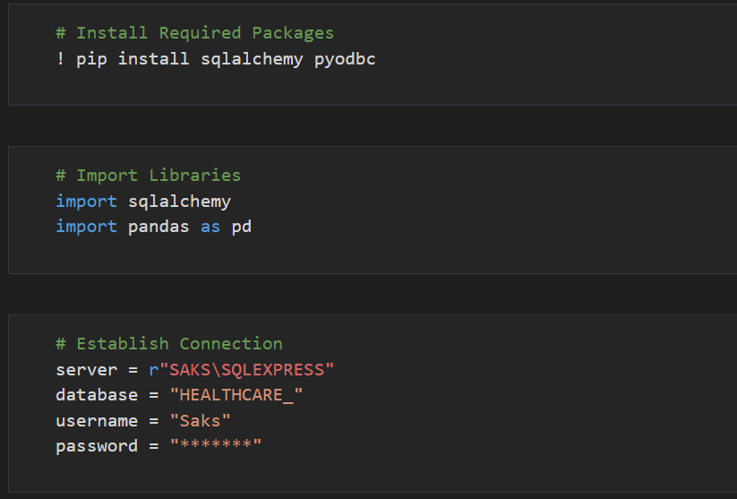
Setting Up the Connection in Python
Image source: icons8`

Slide 28
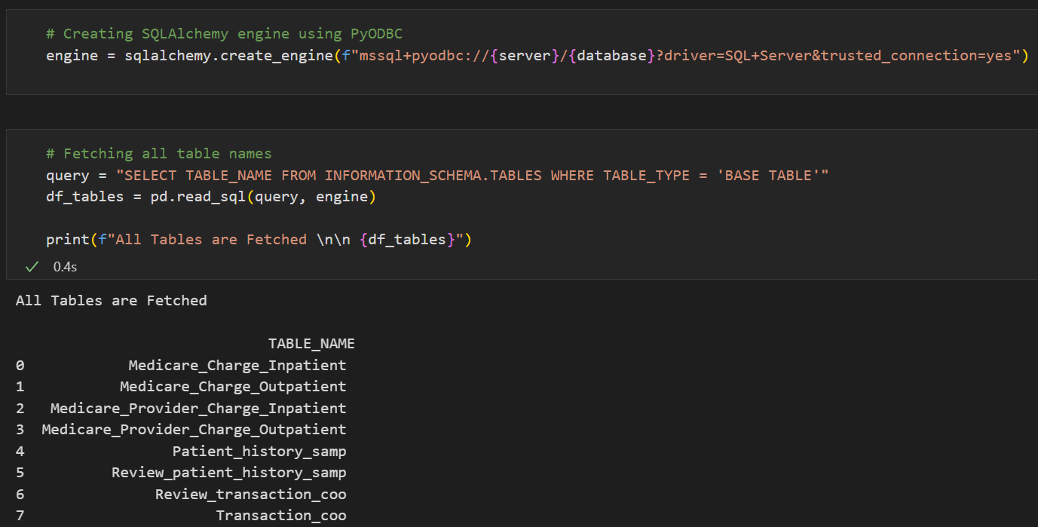
Retrieving Data from SQL Server
Image source: icons8`
Notes:
query = "SELECT TABLE_NAME FROM INFORMATION_SCHEMA.TABLES WHERE TABLE_TYPE = 'BASE TABLE'", consider adding an explanation: The query retrieves all user-defined tables in the database

Slide 29
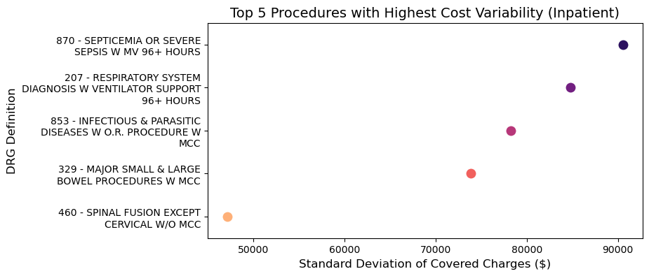
Highest Cost Variation (inpatient)
Notes:
The graph highlights significant cost variability in inpatient procedures, with septicemia, respiratory support, and major surgeries showing the highest fluctuations.

Slide 30
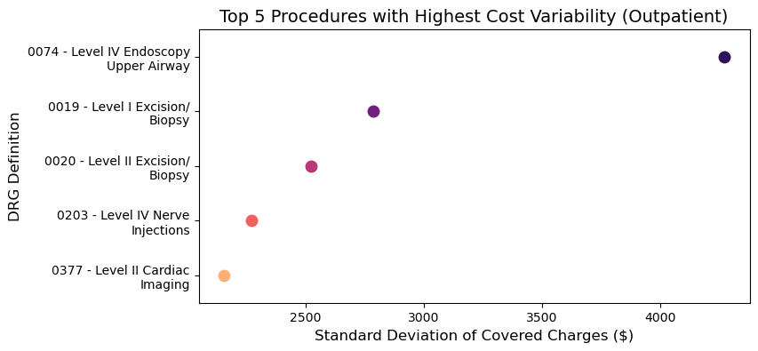
Highest Cost Variation (outpatient)
Image source: icons8`

Slide 31
Highest Cost Variation (Inpatient/Outpatient)
Insights:
High-Cost Variability Across Procedures – Both inpatient and outpatient procedures exhibit significant fluctuations in covered charges.
Complex & Critical Cases Drive Variability – Inpatient procedures like sepsis and respiratory failure, and outpatient procedures like endoscopy and excision/biopsy, show the highest cost variations.
Surgical & Diagnostic Procedures Contribute to Variability – High-cost surgical and imaging procedures impact overall cost trends.
Recommendations:
Standardize Cost Structures – Implement uniform pricing strategies to reduce variability across inpatient and outpatient services.
Leverage Predictive Analytics – Utilize AI-driven cost prediction models to manage unexpected cost variations efficiently.
Image source: icons8`

Slide 32
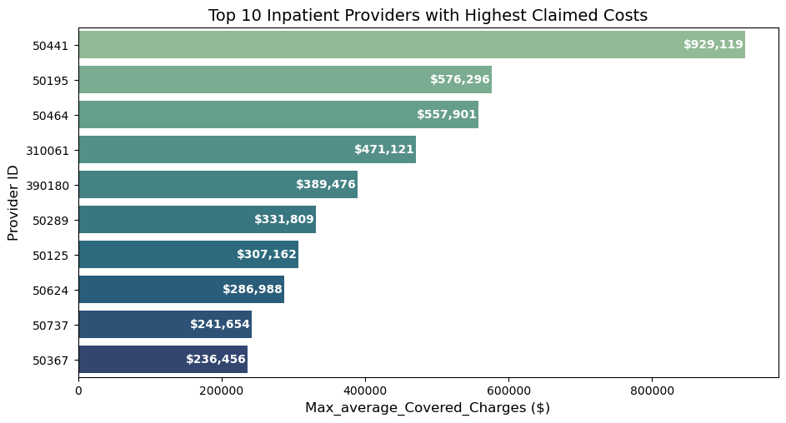
Highest Cost Claims By Provider (inpatient)
Image source: icons8`

Slide 33
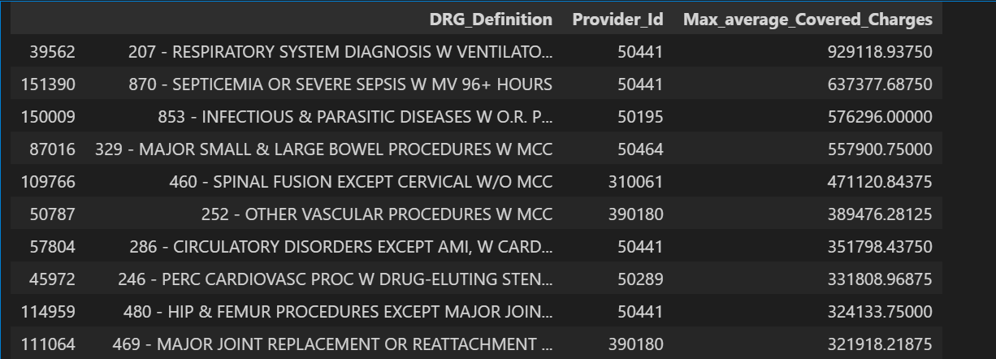
Highest Cost Claims By Provider (inpatient)
Process:
Groups data by Procedure.
Computes Maximum covered charges.
Merges back and filters rows where Max = Avg.
Extracts the Provider charging the max amount.
Provider with the highest claimed cost for a specific inpatient procedure.
Image source: icons8`

Slide 34
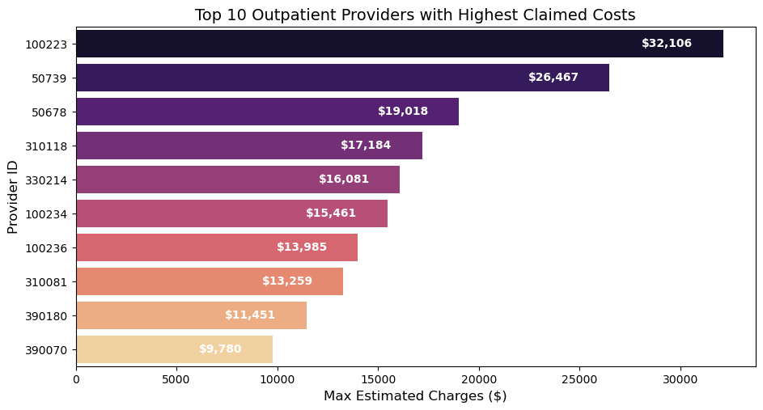
Highest Cost Claims By Provider (outpatient)
Image source: icons8`

Slide 35
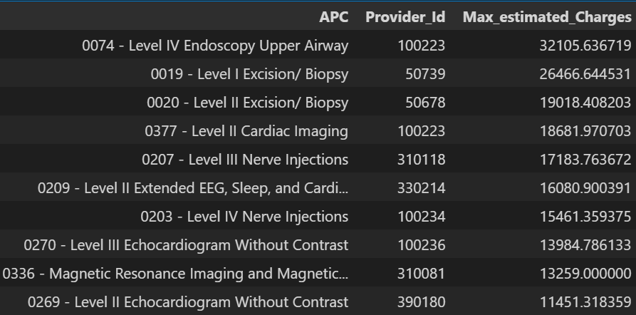
Highest Cost Claims By Provider (outpatient)
Process:
Groups data by Procedure.
Computes Maximum covered charges.
Merges back and filters rows where Max = Avg.
Extracts the Provider charging the max amount.
Provider with the highest claimed cost for a specific outpatient procedure.
Image source: icons8`

Slide 36
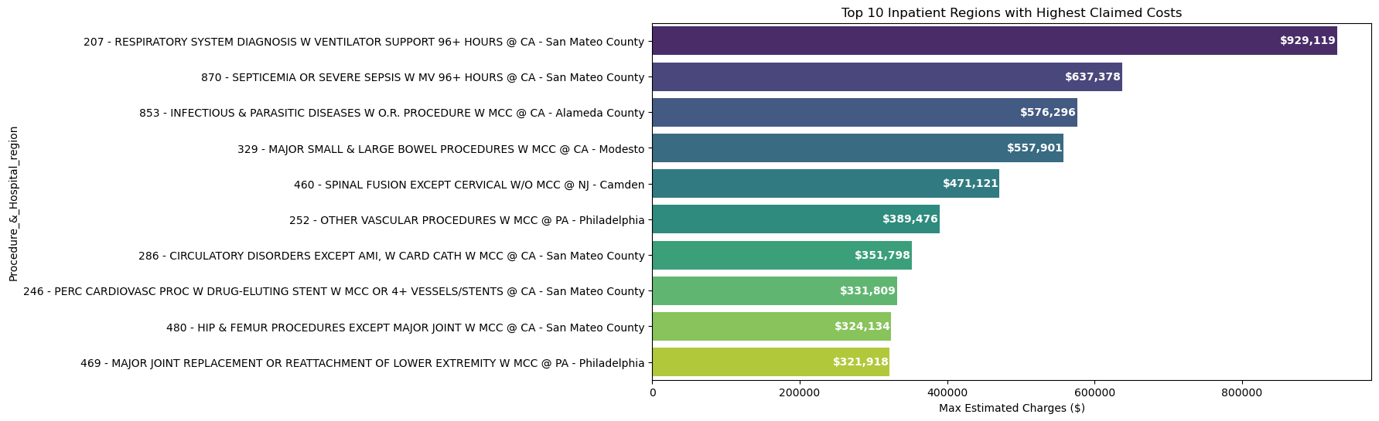
Highest Cost Claims By Region (inpatient)
Inpatient Procedure and region with the highest claimed amount.
Process:
Groups data by Procedure. 2.Computes Maximum covered charges
3.Merges back and filters rows where Max = Avg. 4.Extracts the Region charging the max amount.
Image source: icons8`

Slide 37
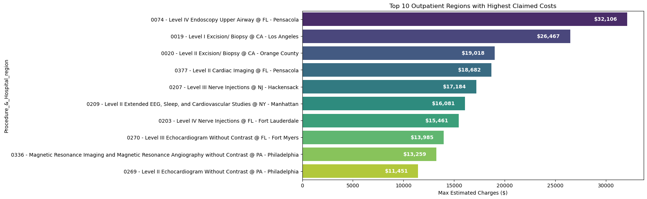
Highest Cost Claims By Region (outpatient)
Outpatient Procedure and region with the highest claimed amount.
Image source: icons8`

Slide 38
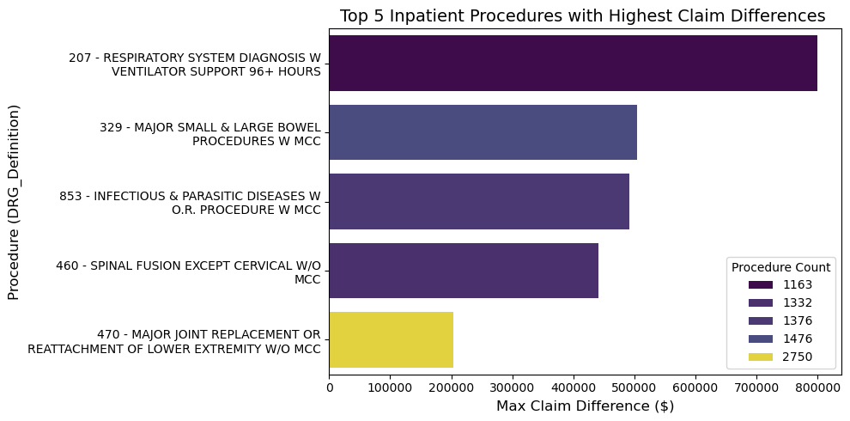
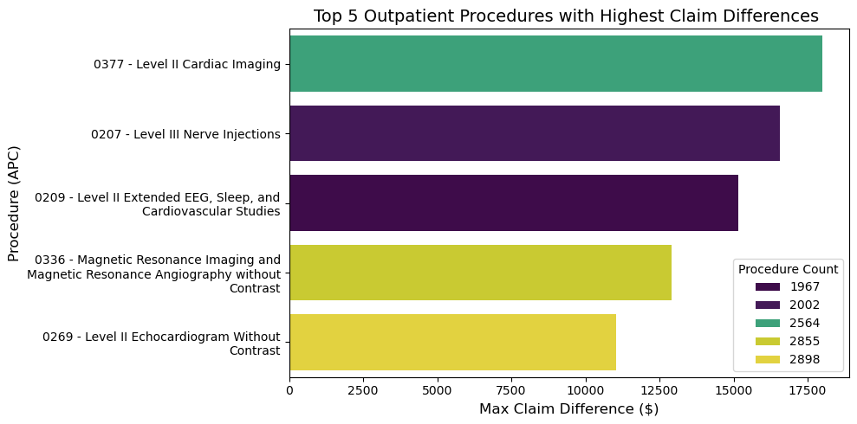
Highest Number of Procedures and Largest Differences between Claims and
Reimbursements
Process:
Find Claim Difference – Compute max claim for each procedure.
Count Occurrences – Get the frequency of each procedure.
Rank Procedures – Rank by claim difference (highest first).
Sort & Retrieve – Order by rank and extract top procedures.
Image source: icons8`

Slide 39
Least Similar Providers and Region
Image source: icons8`

Slide 40
Least Similar Providers
Step-by-Step Process
Step 1: Select Key Features
Step 2: Handle Missing Data
Step 3: Standardize the Data
Step 4: Apply PCA (Dimensionality Reduction)
Step 5: Perform K-Means Clustering
Step 6: Measure Distance from Cluster Centers
Step 7: Identify Least Similar Providers
The least similar providers may have:
Unusual billing patterns
Specialized treatments or higher costs
Potential data anomalies or fraud
Image source: icons8`

Slide 41
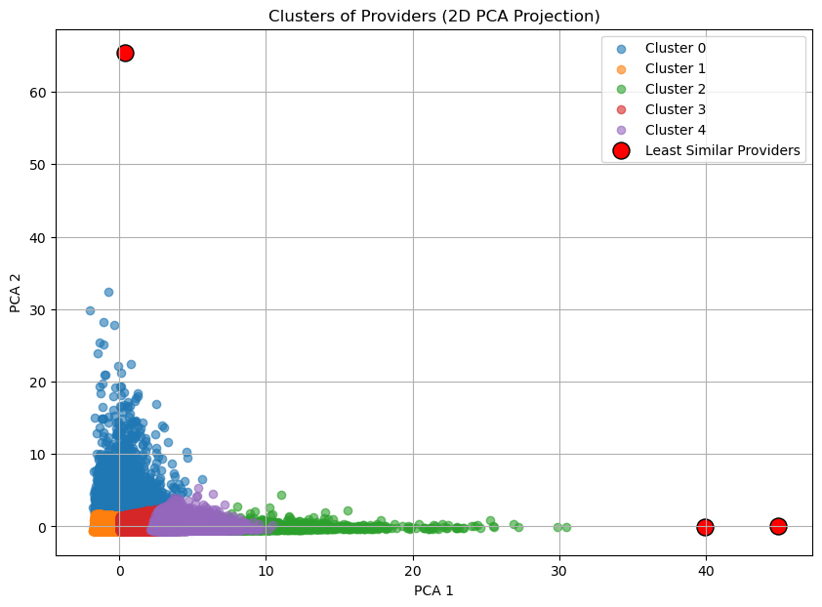
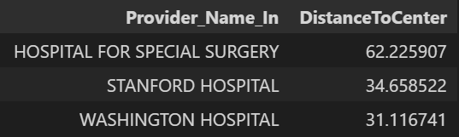
Least Similar Providers
Insights:
Three hospitals (Hospital for Special Surgery, Stanford Hospital, Washington Hospital) are outliers with high DistanceToCenter values.
Most providers follow similar cost patterns, while these outliers have distinct pricing structures.
Recommendations:
Analyse cost structures to understand deviations.
Optimize costs if inefficiencies are found.

Slide 42
Least Similar Providers
Step-by-Step Process
Step 1: Group Data by Region
Step 2: Standardize the Data
Step 3: Apply PCA for Dimensionality Reduction
Step 4: Perform K-Means Clustering
Step 5: Measure Distance from Cluster Centers
Step 6: Identify Least Similar Regions
The least similar regions may have:
Higher or lower-than-average costs
Differences in healthcare policies or patient demographics
Outlier hospitals with unique billing practices
Image source: icons8`

Slide 43
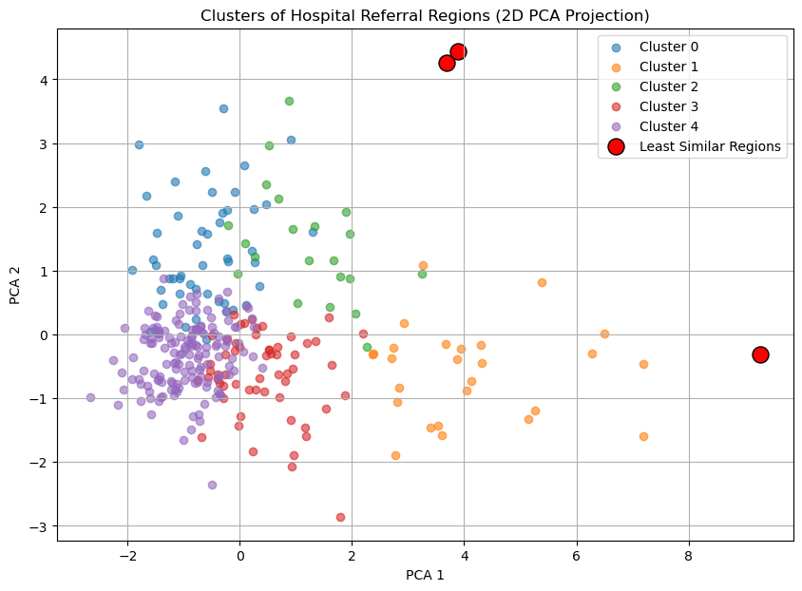
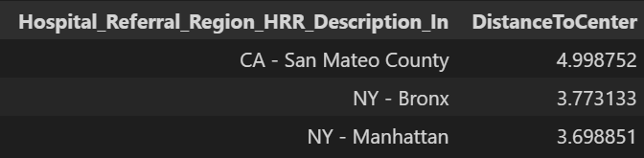
Least Similar Region
Insights:
San Mateo County (CA), Bronx (NY), and Manhattan (NY) are the least similar hospital referral regions.
Outliers suggest unique healthcare ecosystems, possibly influenced by regional policies, income levels, or provider specialization.
Recommendations:
Analyze regional healthcare policies & costs to identify factors driving divergence.
Investigate reimbursement rates & hospital pricing to optimize cost efficiency.
Image source: icons8`

Slide 44
Anomalous Patient Detection
Image source: icons8`

Slide 45
Identifying Anomalous Medicare Patients
Anomaly:
Anomalies are unusual patterns in the dataset that significantly differ from normal records.
These could be patients with abnormally high medical costs, unusual procedures, or unexpected billing patterns.
Approach Used: Isolation Forest
Used the Isolation Forest algorithm to detect anomalous patients.
It assigns an Anomaly Score to each patient, where:
-1 → Anomalous Patient
1 → Normal Patient

Slide 46
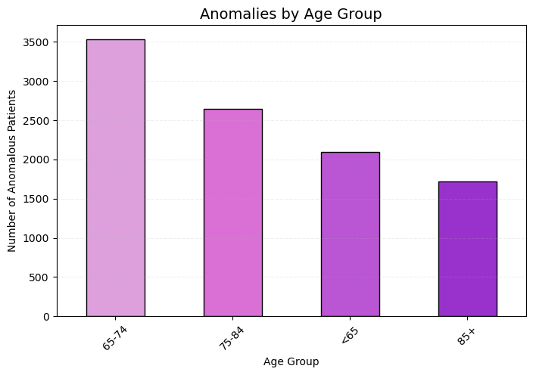
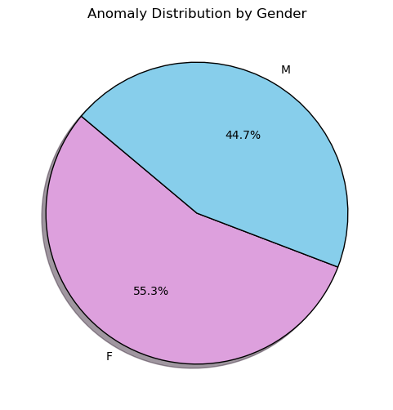
Key Findings from Anomaly Detection
Most anomalies are found in the 65-75 age group, with a slightly higher occurrence in Female
Image source: icons8`

Slide 47
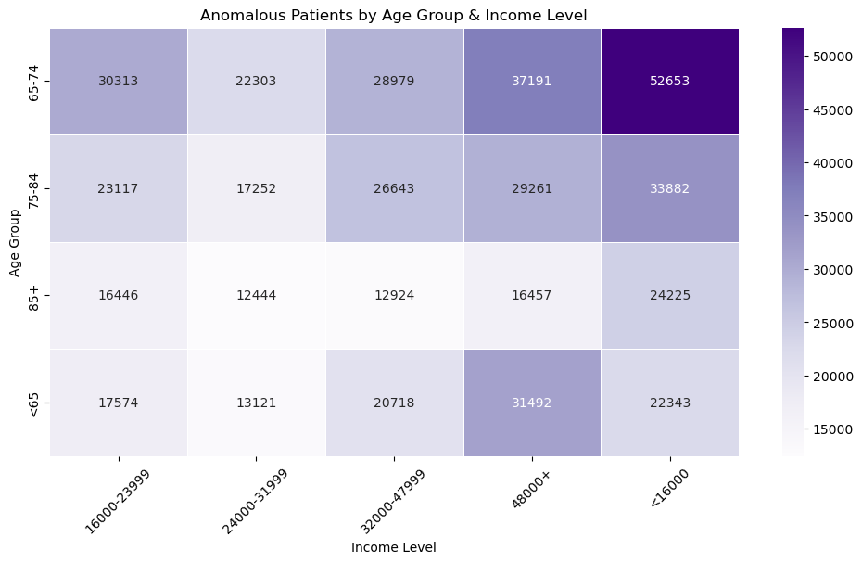
Heatmap of Anomalous Patients by Age Group & Income Level
Patients with mid-to-high income levels exhibit a higher rate of anomalies, suggesting possible fraudulent claims

Slide 48
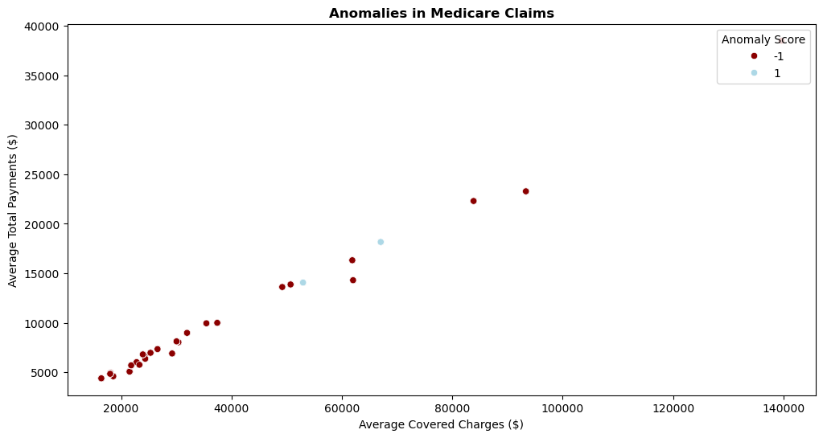
Identifying Anomalies in Medicare Claims
Insights:
High-Cost Claims Are More Anomalous – Most outliers appear in the mid-to-high charge range ($60,000+).
Potential Billing Irregularities – Possible causes include fraud, billing errors, or rare high-cost procedures.
Image source: icons8`

Slide 49
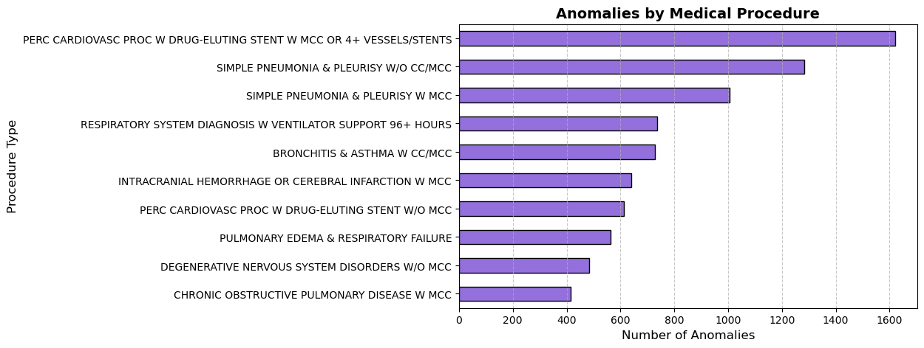
Medical Procedures with High Anomaly Rate
Image source: icons8`

Slide 50
Summary of Anomalies & Key Takeaways
Insights
Age & Income Anomalies:
65-74 age group has the highest anomalies, with females (55.2%) slightly more affected.
Mid-to-high-income patients (₹24,000+) show more anomalies, hinting at potential fraud.
Billing & High-Cost Claims:
High-cost claims ($60,000+) are more prone to anomalies, possibly due to fraud or billing errors.
Medical Procedures with High Anomalies:
Cardiovascular, respiratory, and neurological procedures show the highest anomaly rates.
Recommendations:
Stronger audits for the 65-74 age group and high-income patients.
Review high-cost claims for potential fraud.
Investigate high-risk procedures for billing irregularities.
Use AI for real-time fraud detection to improve claim accuracy.
Image source: icons8`

Slide 51
Predictive Modeling
for
Best Provider Selection
Image source: icons8`

Slide 52
Problem Statement:
Patients struggle to find the best provider.
Healthcare costs for the same procedure vary significantly across hospitals and states.
Lack of transparency in hospital pricing and payment patterns leads to uninformed decision-making.
Importance of Predicting the Best Provider
Helps patients make cost-effective and well-informed healthcare choices.
Reduces financial burden by identifying hospitals with lower charges and optimal care.
Model Objective
Predicts the best provider for a given procedure based on cost and payment patterns.
Provides transparency in hospital pricing for better healthcare accessibility.
Image source: icons8`

Slide 53
Data Overview
Datasets Used
Medicare_Provider_Charge_Inpatient
Medicare_Provider_Charge_Outpatient
Key Columns Used in Analysis
DRG Definition /APC– Diagnosis-related group (procedure category)
Provider ID – Unique id for Provider
Provider State – Location of the hospital
Total Discharge – Discharge for each procedure
Average Covered Charges – Amount billed by the hospital
Average Total Payments – Amount paid by Medicare/insurer
Image source: icons8`

Slide 54
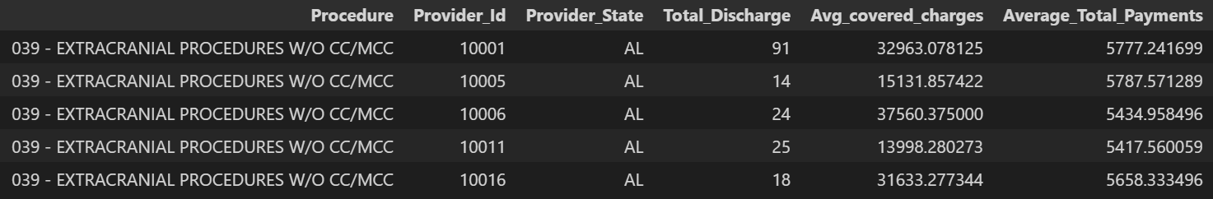
Data Processing & Feature Engineering
Renaming columns:
Inpatient data -"DRG_Definition":"Procedure","Total_Discharges":"Total_Discharge","Average_Covered_Charges":"Avg_covered_charges"
Outpatient data -"APC":"Procedure","Outpatient_Services":"Total_Discharge","Average_Estimated_Submitted_Charges":"Avg_covered_charges“
Encoding categorical data using Label Encoder
Categorical column like Procedure and Provider state are encoded
Features used for training the model
Image source: icons8`

Slide 55
Model Selection & Training
XGBoost Regressor
XGBoost (Extreme Gradient Boosting) is a powerful ensemble learning algorithm used for regression tasks. It utilizes boosting to iteratively improve weak models, resulting in high accuracy and efficiency.
Why Use XGBoost Regressor?
Handles Large Datasets Efficiently – Optimized for speed and performance, even with high-dimensional data.
Reduces Overfitting – Uses regularization techniques like L1 and L2 to prevent overfitting.
High Accuracy – Boosting corrects errors from previous models, leading to better predictions
Handles Missing Values & Outliers – Can effectively deal with noisy and incomplete data.
Steps in Training the Model
Splitting Data – 80% for training, 20% for testing.
Training the Model – XGBoost is trained with optimal hyperparameters.
Prediction – The model predicts hospital costs for test data.
Evaluation – The model is evaluated using R² score (coefficient of determination) to assess its predictive power.
Model Selection – XGBoost was selected based on achieving the highest R² score compared to other models.
Image source: icons8`

Slide 56
Prediction
How Predictions are Made
The trained XGBoost model predicts hospital charges based on input features (e.g., procedure type, location).
Given a patient's required procedure and state, the model estimates total payments across providers.
The Providers are ranked based on the lowest predicted charges to help patients make cost-effective decisions.
Image source: icons8`

Slide 57
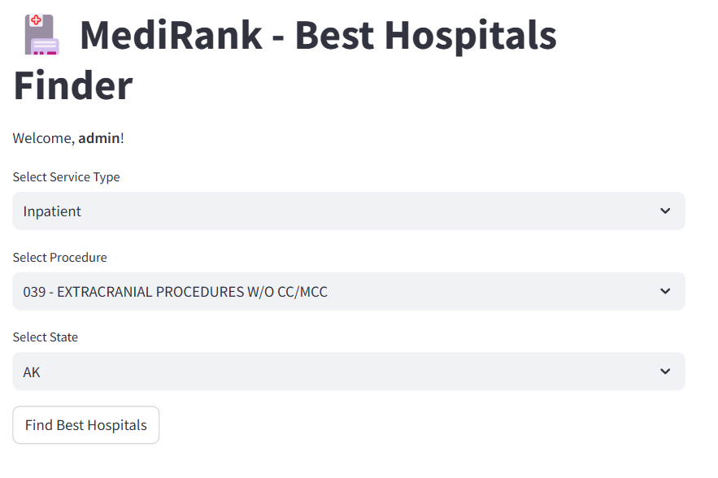
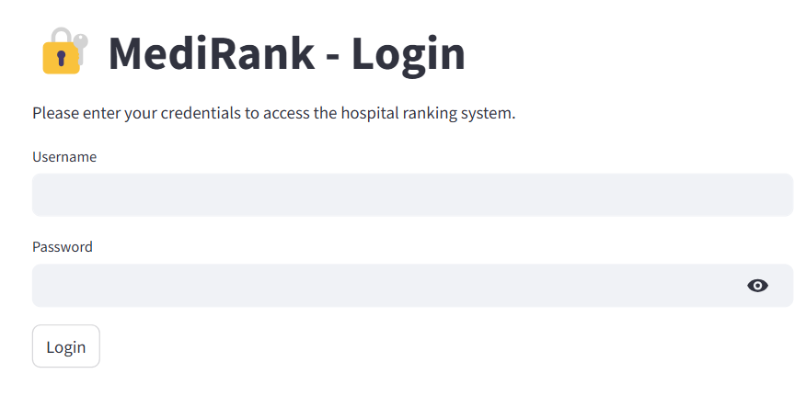
Streamlit Web Application

Slide 58
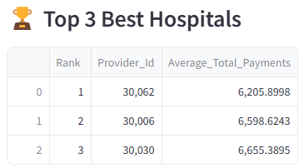
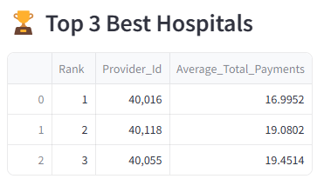
Sample result
Sample 1
Sample 2
Service Type : Inpatient
Procedure : 039 - EXTRACRANIAL PROCEDURES W/O CC/MCC
State : AZ
Service Type : Outpatient
Procedure : 0012 - Level I Debridement & Destruction
State : AR

Slide 59
Thank you!

